Slide 1
Craft Beer in America
The quest to update an outdated snapshot of America’s craft beer scene

Slide 2
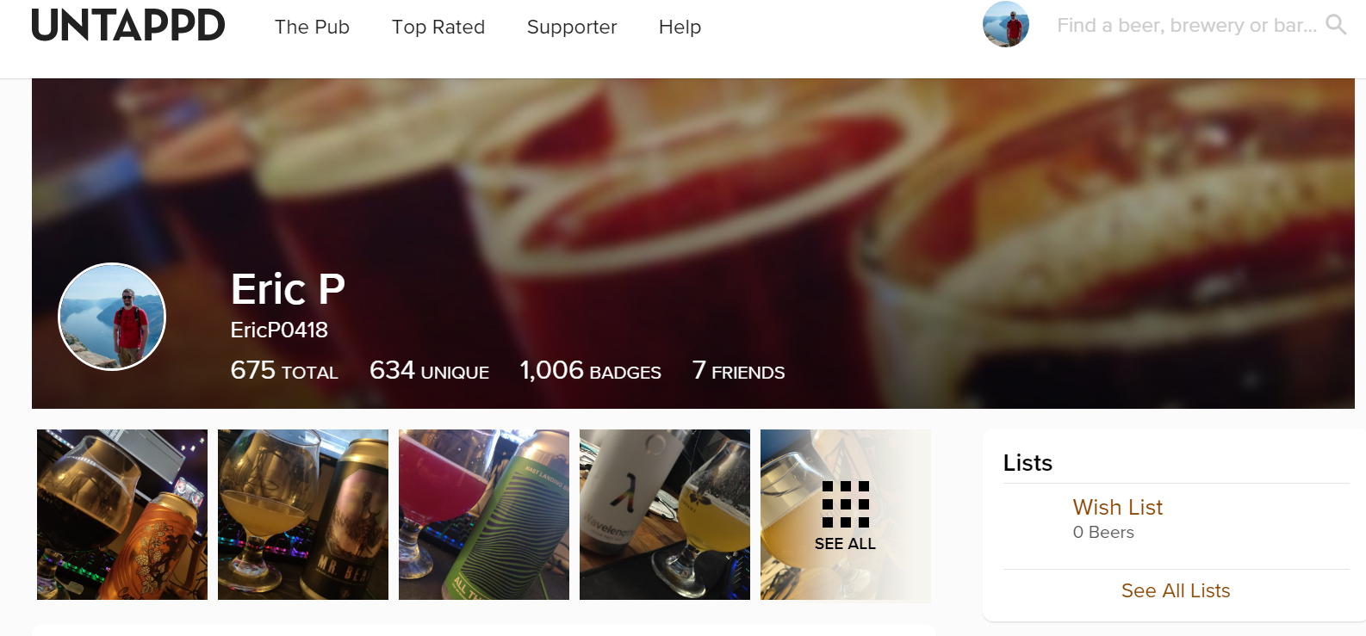
Why I chose this project...

Slide 3
Questions I want answered:
Exactly how popular is the craft beer scene?
Is this popularity the same nationwide? Or are there hotspots/coldspots?
Is there a clear ‘best place’ for craft beer? Or an even distribution?
What type of beer is most popular?
Is there a distinct favorite style of beer (IPA, stout, sour, etc.)? Or are all beer variations seen as being similar?
Have people’s preference in beer types changed since 2012? Or remained the same?
Does ABV % change any of this?
What brewery is the champ? GOAT or one hit wonder?
aka Where am I traveling to next?

Slide 4
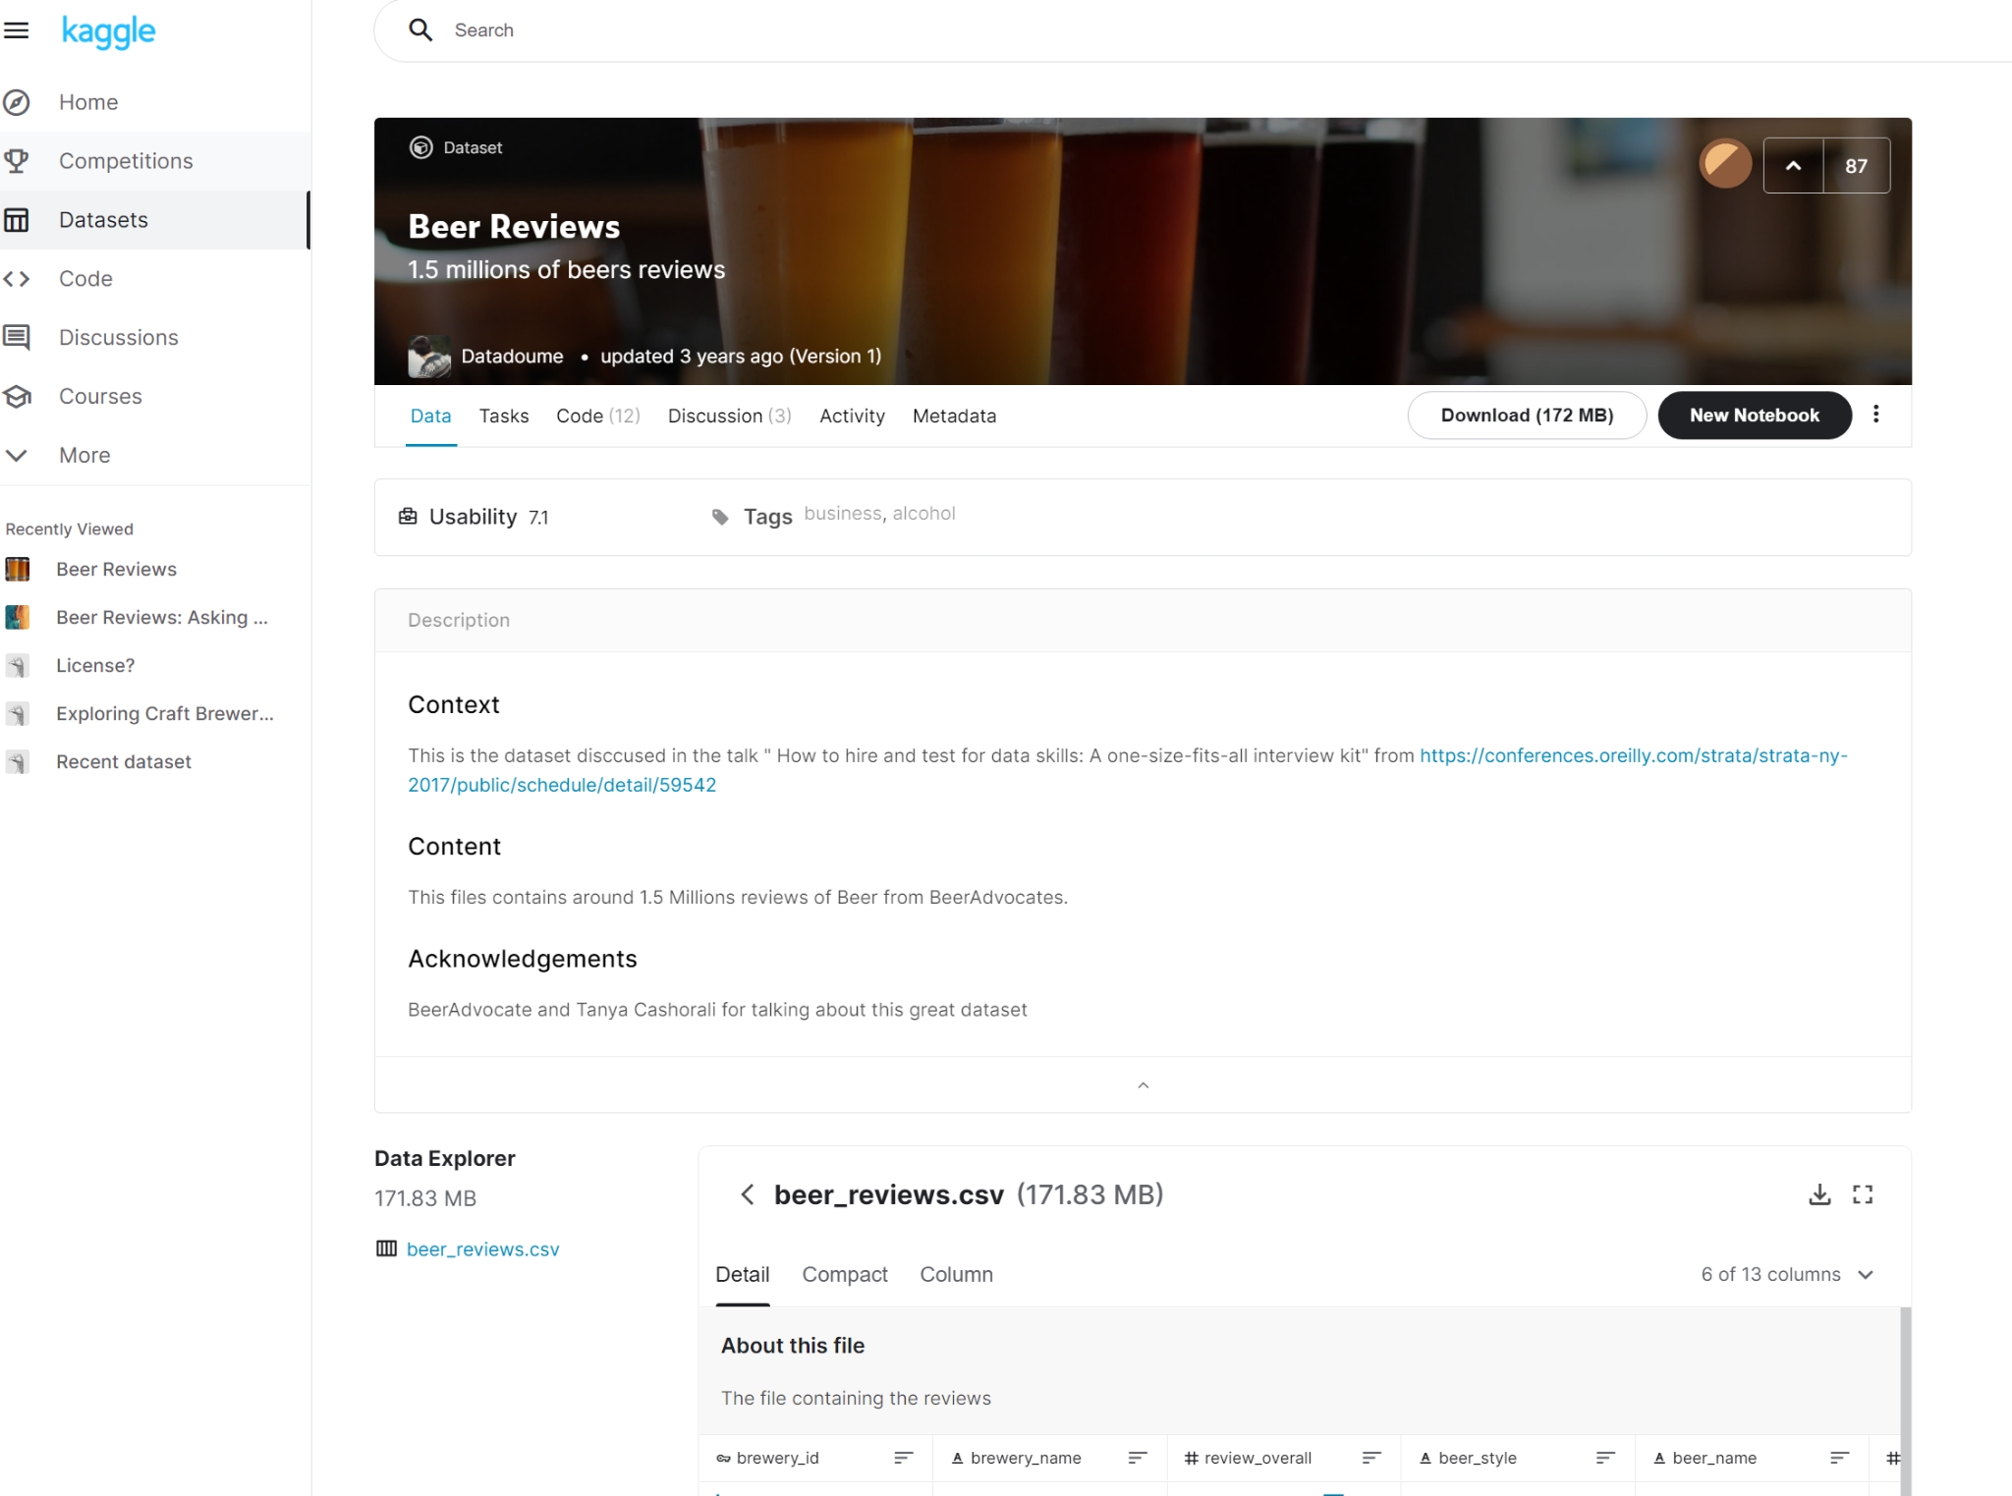
Where it started:

Slide 5
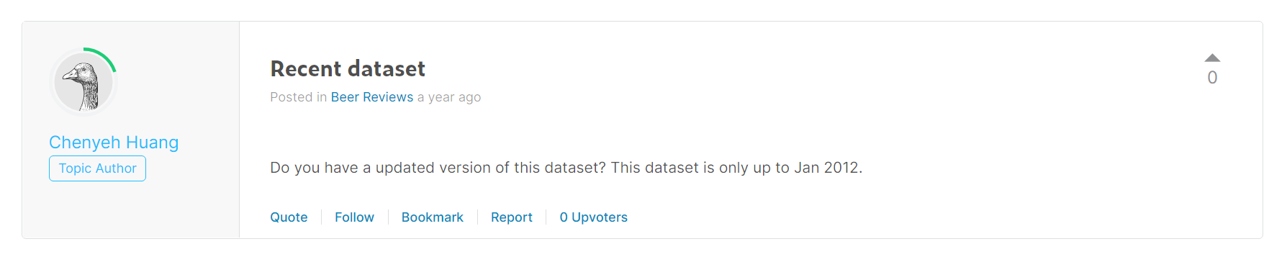
...it’s from WHEN?
Pros: Large dataset (1.5 Million reviews), wide variety of breweries and easy to understand
Cons: Treated as individual reviews (duplicate beers), no easy geographic sorting/analysis, and OUTDATED

Slide 6
What I want in a data set
Reviews/ratings summed, not individually listed per beer
Geographic data formatted simply and in an easily digestible style
An even selection from every state in the US, with no bias (more breweries from certain states) to give the analysis for best beers/breweries the most even playing field
….where do I get this?

Slide 7


Slide 8

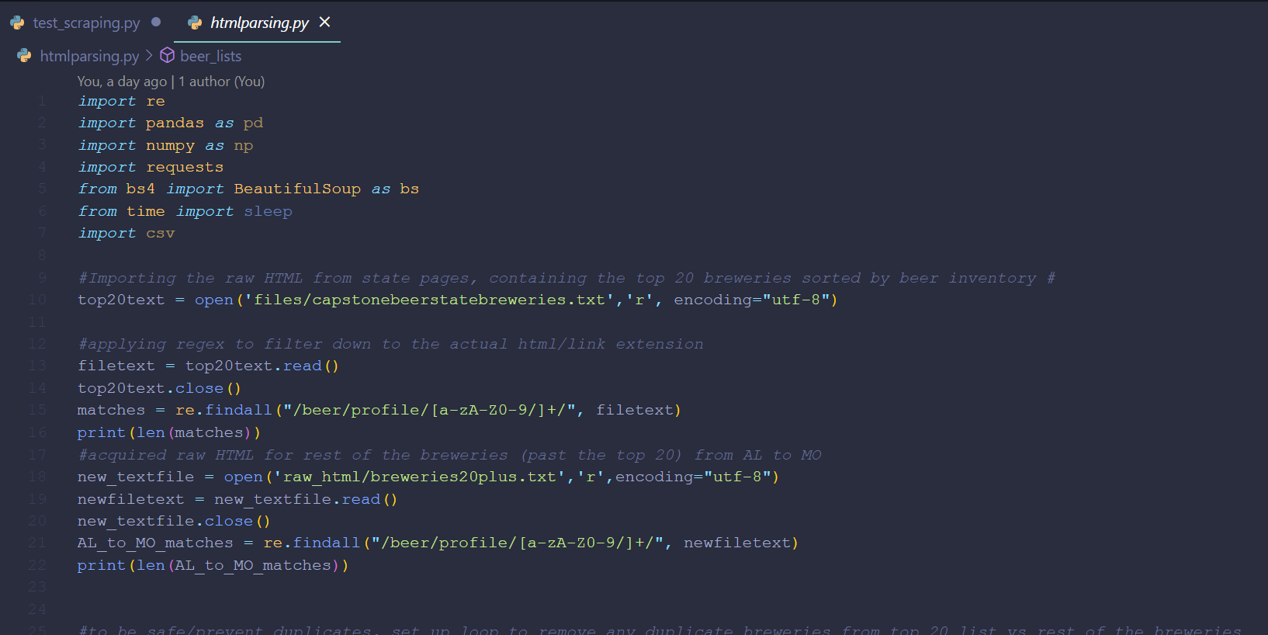
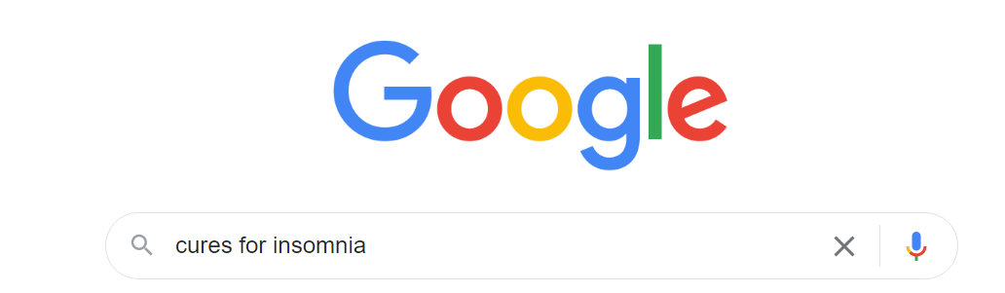
Which led to….

Slide 9

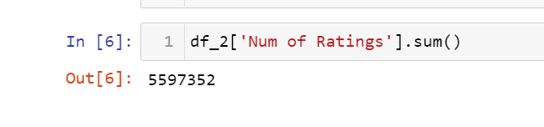
But finally resulted in....

Slide 10
Time for the Findings!

Slide 11
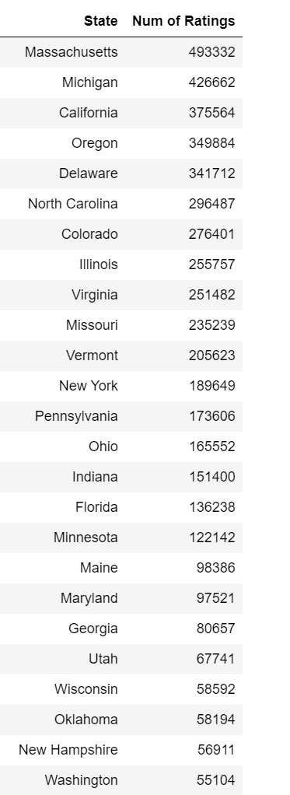
Is this popularity the same nationwide? Or are there hotspots/coldspots?
More Variety than I expected
11 States over 200,000 reviews
17 States over 100,000 reviews

Slide 12
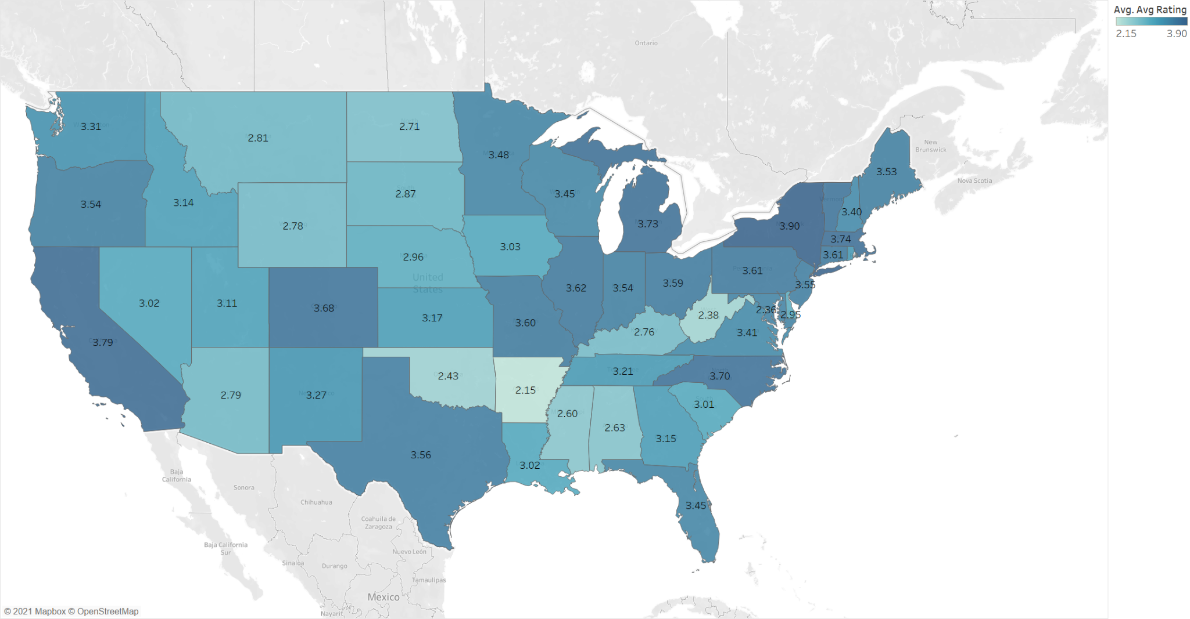
Is there a clear ‘best place’ for craft beer? Or an even distribution?
California and Northeast are hotspots
Everywhere else seems to be fairly evenly distributed
(except for WV and AR..ouch)

Slide 13
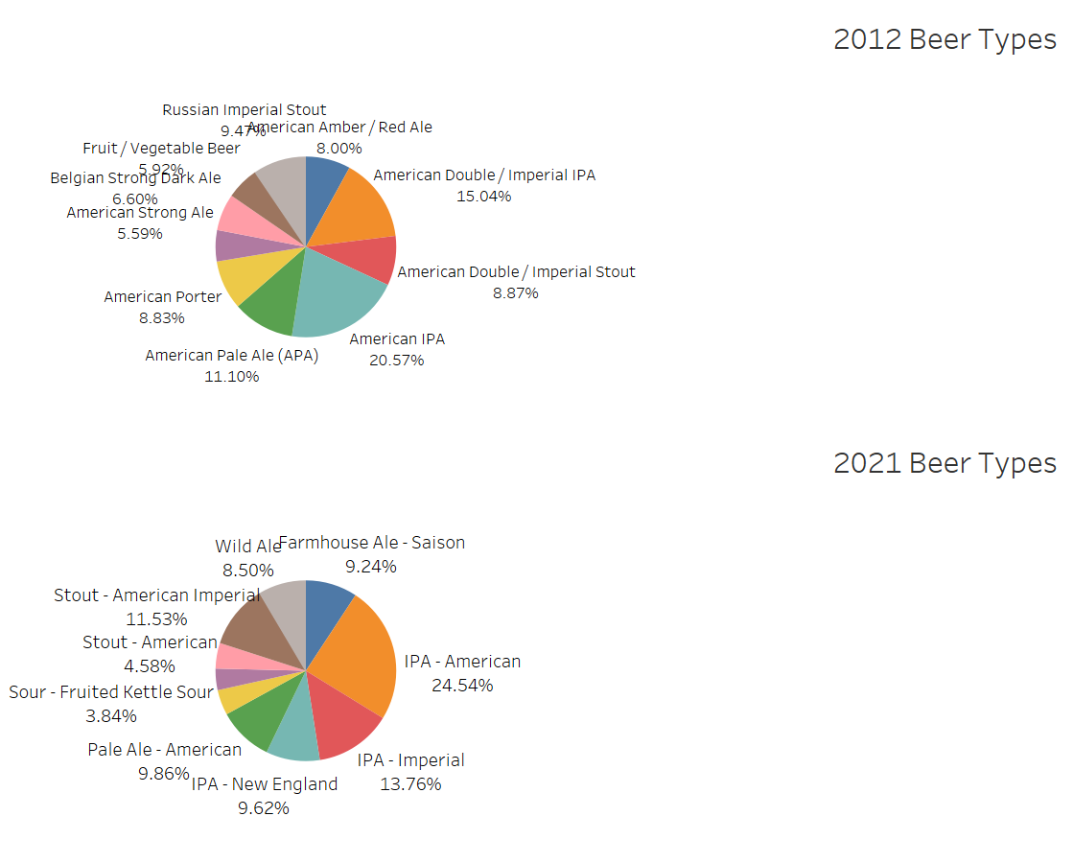
Is there a distinct favorite style of beer (IPA, stout, sour, etc.)? Or are all beer variations seen as being similar?
Have people’s preference in beer types changed since 2012? Or remained the same?
India Pale Ales (IPAs) are the mainstays, which has remained true from 2012 to 2021
Stouts make up a larger portion than I thought - showing that darker, stronger and more intense beers can outnumber some of the IPA varieties

Slide 14
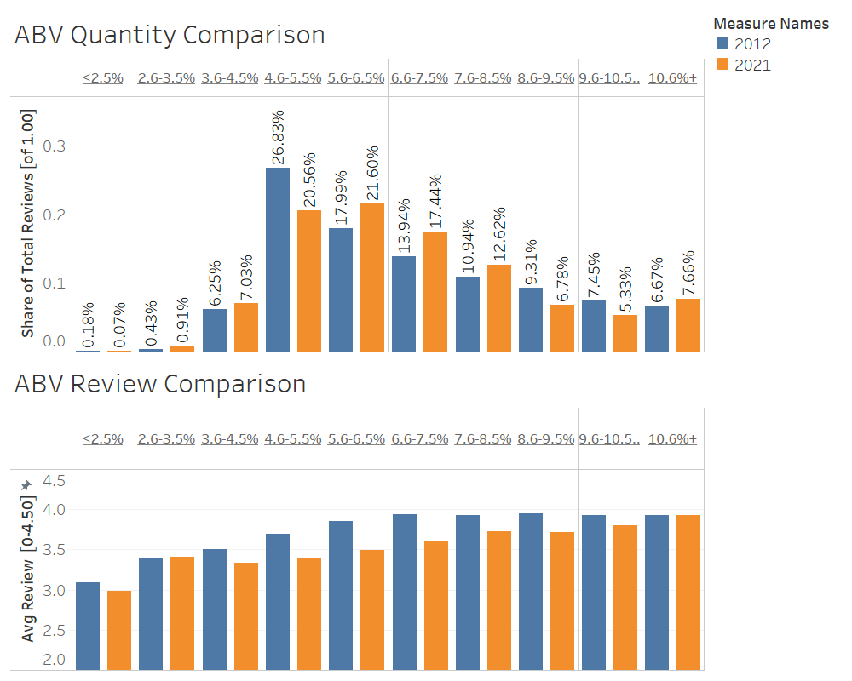
Does Alcohol By Volume (ABV %) change any of this?
Following the trend of IPA’s being favorites - their associated ABV % ranges (4.6-7.5%) make up the majority of ABV entries
Stronger (higher ABV %) have risen in popularity/market share from 2012 to 2021
Review scores continue to rise with ABV % past the IPA/popular ranges, reflecting the presence of mature/barrel aged darker beers in these ABV ranges

Slide 15
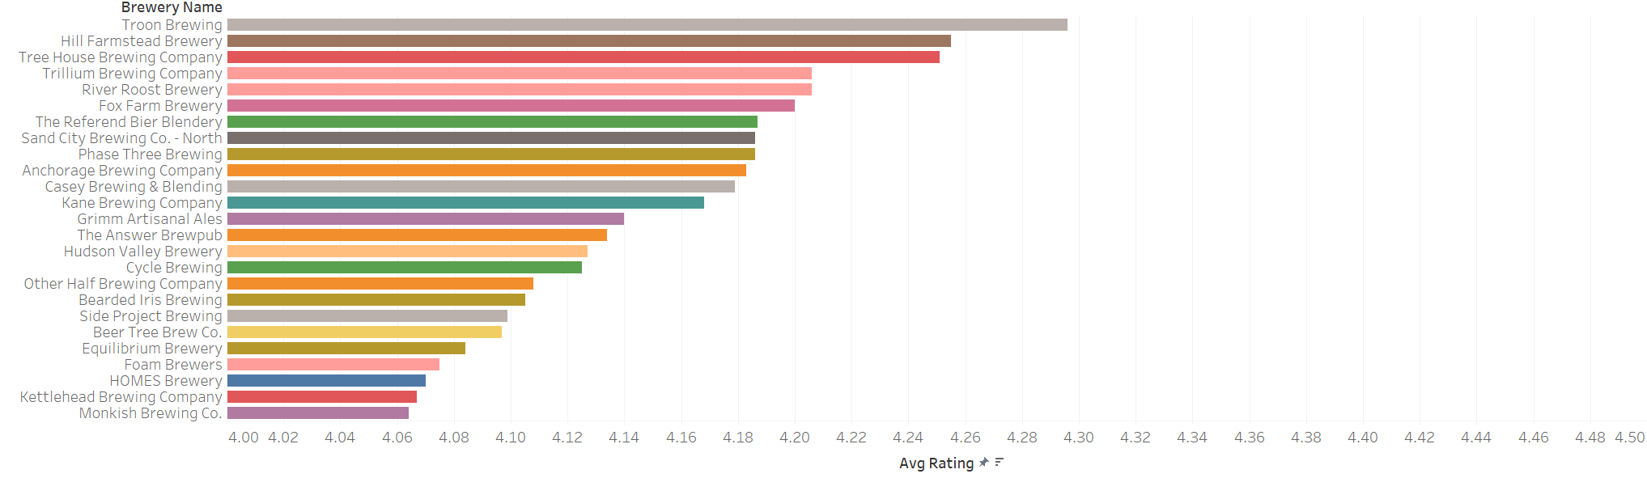
What brewery is the champ? GOAT or one hit wonder?

Slide 16
In Summary
The craft beer scene is popular across a wide part of the US, with the ‘best beer’ being found in the Northeast and California
IPAs are the most popular type, followed by stouts
ABV % does have a connection with beer rating, potentially showing the higher ABV % beers (barrel aged/multiple hop sessions/etc.) are only handled by higher tier/quality brewers
Beer is awesome

Slide 17
Questions?

